Slide 1
FYP5: Object Detection, Tracking and Suspicious Activity Recognition for Maritime Surveillance using Thermal Vision

Slide 2
Weekly Tasks
Continuation of the object detection model
POC level of horizon detection
Go through mechanical stabilization – ISP
Literature review of Suspicious Activity Recognition
Contact FLIR regarding thermal dataset

Slide 3
Object Detection through Transfer Learning

Slide 4
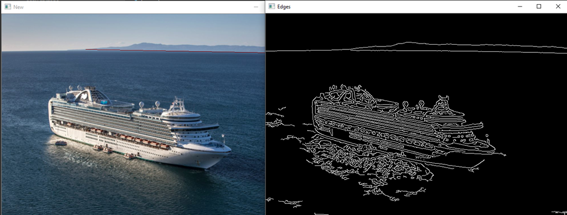
Horizon Detection for Stabilization 1. Using Canny edge detector Hough transform

Slide 5
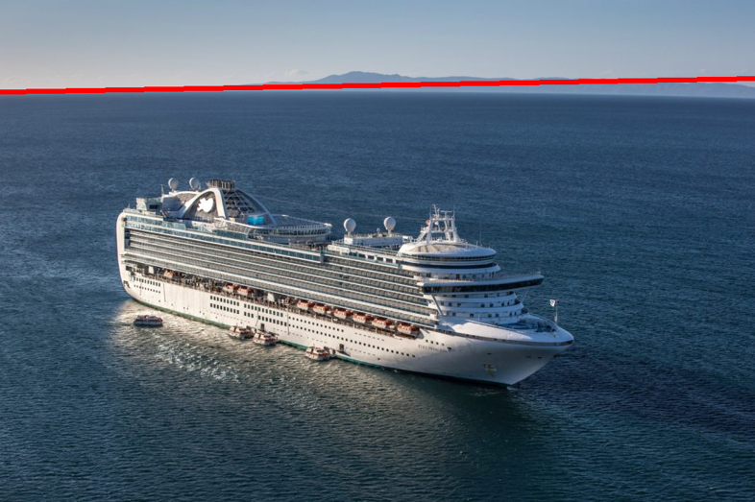
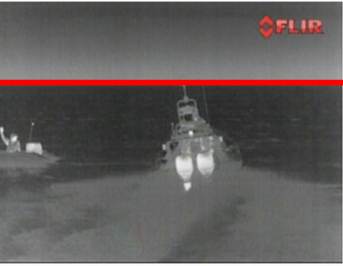
Horizon Detection for Stabilization 2. Two-Stage Global and Local Objectives

Slide 6
Inertially Stabilized Platforms (ISP)
Went through two survey papers
System Performance of an Inertially Stabilized Gimbal Platform with Friction, Resonance, and Vibration Effects – Research Paper IEEE
Inertially Stabilized Platform Technology by J.M. HILKERT - CONCEPTS AND PRINCIPLES
Topics Identified for further reading
Control system designs (Motor controller, Motor rate controller, Angular positioning control loop)
Basic Gyro Modeling
Various control system algorithms (State variable feedback/ Adaptive techniques/ Design Observation design etc.)
Multiaxis Dynamics (Euler Transformations, Kinematic coupling)
ADC conversion methods under Gyro modeling
Gimbal/ Structure design (Modal analysis)
Friction and Internal vibration analysis
Gimbal dynamics and kinematics

Slide 7
Literature Review on Suspicious Activity Recognition

Slide 8

Tasks for next week
Go through the identified topics of ISP
Literature review on Suspicious Activity Recognition
Horizon Detection
Transfer Learning other than FRCNN

